Slide 1
Lecture # 7
Week 3rd
Spring 2021
These slides contains materials taken from various sources. I fully acknowledge all copyrights

Slide 2
Chapter 1: roadmap
  1.1 what is the Internet?
  1.2 network edge
    end systems, access networks, links
  1.3 network core
    packet switching, circuit switching, network structure
  1.4 delay, loss, throughput in networks
  1.5 protocol layers, service models
  1.6 networks under attack: security
  1.7 history
Introduction
1-<number>

Slide 3

How do loss and delay occur?
packets queue in router buffers
packet arrival rate to link (temporarily) exceeds output link capacity
packets queue, wait for turn
packet being transmitted (delay)
Takes time to put bits on link, or transmitting packet =TRANMISSION DELAY
A
B
packets queueing (delay) packets in Queue =QUEING DELAY
free (available) buffers: arriving packets
dropped (loss) if no free buffers
Three white slot filled up loss
Introduction
1-<number>

Slide 4
Four sources of packet delay
transmission
A
propagation
B
nodal
processing
queueing
d_{nodal} = d_{proc} + d_{queue} + d_{trans} + d_{prop}
d_{proc}: processing
check bit errors
determine output link
typically < msec
d_{queue}: queueing delay
time waiting at output link for transmission
depends on congestion level of router
Introduction
1-<number>

Slide 5
Four sources of packet delay
transmission
A
propagation
B
nodal
processing
queueing
d_{nodal} = d_{proc} + d_{queue} + d_{trans} + d_{prop}
d_{trans}: transmission delay:
L: packet length (bits)
R: link bandwidth (bps)
d_{trans} = L/R
d_{prop}: propagation delay:
d: length of physical link
s: propagation speed (~2x10⁸ m/sec)
d_{prop} = d/s
d_{trans} and d_{prop}
very different
* Check out the online interactive exercises for more examples: http://gaia.cs.umass.edu/kurose_ross/interactive/
* Check out the Java applet for an interactive animation on trans vs. prop delay
Introduction
1-<number>

Slide 6
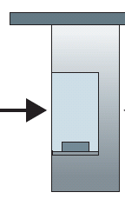

Caravan analogy
100 km
100 km
ten-car
caravan
toll
booth
toll
booth
DATA
cars “propagate” at
100 km/hr
toll booth takes 12 sec to service car (bit transmission time)
car ~ bit;
caravan ~ packet
Q: How long until caravan is lined up before 2nd toll booth?
time to “push” entire caravan through toll booth onto highway = 12*10 = 120 sec
time for last car to propagate from 1st to 2nd toll both: 100km/(100km/hr)= 1 hr
A: 62 minutes
Introduction
1-<number>

Slide 7
Caravan analogy (more)
100 km
100 km
ten-car
caravan
toll
booth
toll
booth
suppose cars now “propagate” at 1000 km/hr
and suppose toll booth now takes one min to service a car
Q: Will cars arrive to 2nd booth before all cars serviced at first booth?
A: Yes! after 7 min, first car arrives at second booth; three cars still at first booth
Introduction
1-<number>

Slide 8
Comparing Transmission and Propagation Delay
The difference is subtle but important. The transmission delay is the amount of time required for the router to push out the packet; it is a function of the packet’s length and the transmission rate of the link, but has nothing to do with the distance between the two routers.
The propagation delay, on the other hand, is the time it takes a bit to propagate from one router to the next; it is a function of the distance between the two routers, but has nothing to do with the packet’s length or the transmission rate of the link.
Introduction
1-<number>

Slide 9
(Nodal) Processing Delay
The (nodal) processing delay is every device along the communication path that actually processes/examines the packets; these include routers, switches, and statistical multiplexers. The receiver doesn’t count towards this delay because the receiver is the receiver and has received the packet at that point, it doesn’t matter what will be done on its side with the signal.
(Total) Nodal Delay
The (total) nodal delay on the other hand is the sum of all latency delays. There are exactly four delays:
(Nodal) Processing Delay amount of time used to process the packet headers, check for bit errors and determine the destination host.
Queuing Delay amount of time a packet is waiting in the queue (buffer) before it can be pushed on the link.
Transmission Delay amount of time necessary to push all the bits on the link.
Propagation Delay amount of time it takes the signal’s header to travel from the sender to the receiver.
d_{nodal} = d_{proc} + d_{queue} + d_{trans} + d_{prop}
Introduction
1-<number>

Slide 10
As a packet travels from one node (host or router) to the subsequent node (host or router) along this path, the packet suffers from several types of delays at each node along the path. The most important of these delays are the nodal processing delay, queuing delay, transmission delay, and propagation delay; together, these delays accumulate to give a total nodal delay.
Introduction
1-<number>

Slide 11
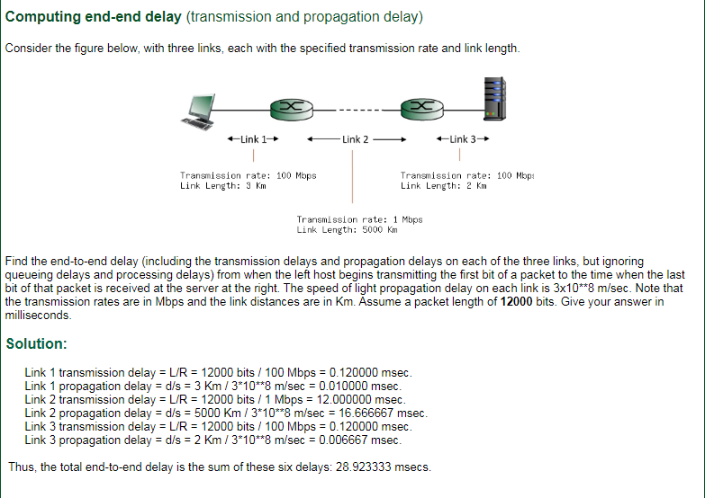
Introduction
1-<number>

Slide 12


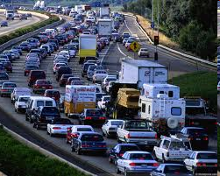
Queueing delay (revisited)
R: link bandwidth (bps)
L: packet length (bits)
a: average packet arrival rate
average queueing delay
traffic intensity
= La/R
La/R ~ 0: avg. queueing delay small
La/R -> 1: avg. queueing delay large
La/R > 1: more “work” arriving
than can be serviced, average delay infinite!
La/R ~ 0
La/R -> 1
* Check online interactive animation on queuing and loss
Introduction
1-<number>

Slide 13
“Real” Internet delays and routes
what do “real” Internet delay & loss look like?
traceroute program: provides delay measurement from source to router along end-end Internet path towards destination. For all i:
  sends three packets that will reach router i on path towards destination (with time-to-live field value of i)
  router i will return packets to sender
  sender measures time interval between transmission and reply
3 probes
3 probes
3 probes
Introduction: 1-<number>

Slide 14
Real Internet delays and routes
traceroute: gaia.cs.umass.edu to www.eurecom.fr
3 delay measurements from
gaia.cs.umass.edu to cs-gw.cs.umass.edu
1 cs-gw (128.119.240.254) 1 ms 1 ms 2 ms
2 border1-rt-fa5-1-0.gw.umass.edu (128.119.3.145) 1 ms 1 ms 2 ms
3 cht-vbns.gw.umass.edu (128.119.3.130) 6 ms 5 ms 5 ms
4 jn1-at1-0-0-19.wor.vbns.net (204.147.132.129) 16 ms 11 ms 13 ms
5 jn1-so7-0-0-0.wae.vbns.net (204.147.136.136) 21 ms 18 ms 18 ms
6 abilene-vbns.abilene.ucaid.edu (198.32.11.9) 22 ms 18 ms 22 ms
7 nycm-wash.abilene.ucaid.edu (198.32.8.46) 22 ms 22 ms 22 ms
8 62.40.103.253 (62.40.103.253) 104 ms 109 ms 106 ms
9 de2-1.de1.de.geant.net (62.40.96.129) 109 ms 102 ms 104 ms
10 de.fr1.fr.geant.net (62.40.96.50) 113 ms 121 ms 114 ms
11 renater-gw.fr1.fr.geant.net (62.40.103.54) 112 ms 114 ms 112 ms
12 nio-n2.cssi.renater.fr (193.51.206.13) 111 ms 114 ms 116 ms
13 nice.cssi.renater.fr (195.220.98.102) 123 ms 125 ms 124 ms
14 r3t2-nice.cssi.renater.fr (195.220.98.110) 126 ms 126 ms 124 ms
15 eurecom-valbonne.r3t2.ft.net (193.48.50.54) 135 ms 128 ms 133 ms
16 194.214.211.25 (194.214.211.25) 126 ms 128 ms 126 ms
17 * * *
18 * * *
19 fantasia.eurecom.fr (193.55.113.142) 132 ms 128 ms 136 ms
3 delay measurements
to border1-rt-fa5-1-0.gw.umass.edu
trans-oceanic link
looks like delays decrease! Why?
* means no response (probe lost, router not replying)
* Do some traceroutes from exotic countries at www.traceroute.org
Introduction: 1-<number>

Slide 15
Packet loss
queue (aka buffer) preceding link in buffer has finite capacity
packet arriving to full queue dropped (aka lost)
lost packet may be retransmitted by previous node, by source end system, or not at all
buffer
(waiting area)
packet being transmitted
A
B
packet arriving to
full buffer is lost
* Check out the Java applet for an interactive animation (on publisher’s website) of queuing and loss
Introduction: 1-<number>

Slide 16
Throughput
throughput: rate (bits/time unit) at which bits transferred between sender/receiver
  instantaneous: rate at given point in time
  average: rate over longer period of time
server, with
file of F bits
to send to client
link capacity
R_{s} bits/sec
link capacity
R_{c} bits/sec
server sends bits
(fluid) into pipe
pipe that can carry
fluid at rate
R_{s} bits/sec)
pipe that can carry
fluid at rate
R_{c} bits/sec)
Introduction
1-<number>

Slide 17
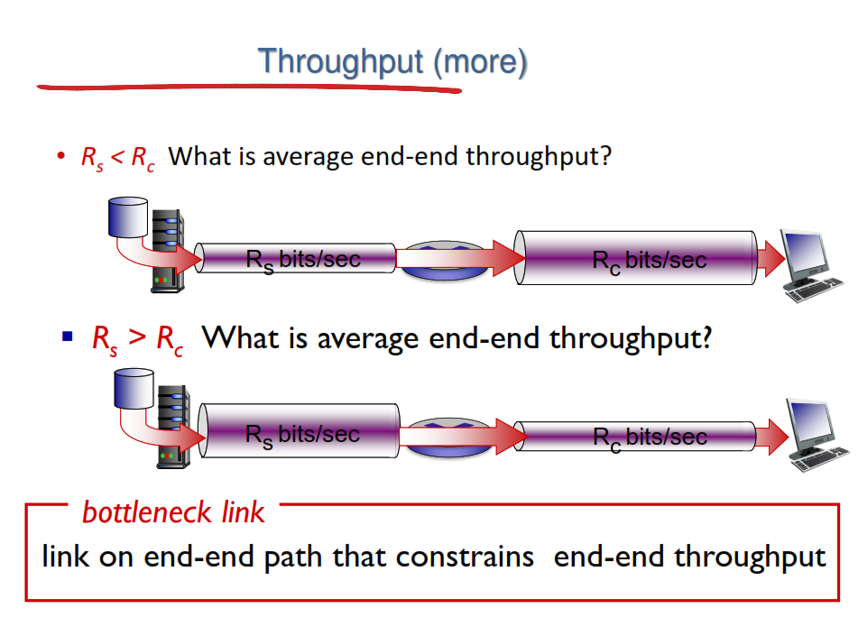
Introduction
1-<number>

Slide 18
A Network bottleneck or Bottleneck Link refers to a discrete condition in which data flow is limited by computer or network resources. The flow of data is controlled according to the bandwidth of various system resources. If the system working on a network is delivering a higher volume of data than what is supported by the existing capacity of the network, then a network bottleneck will occur.
https://www.techopedia.com/definition/24819/network-bottleneck
Introduction
1-<number>

Slide 19
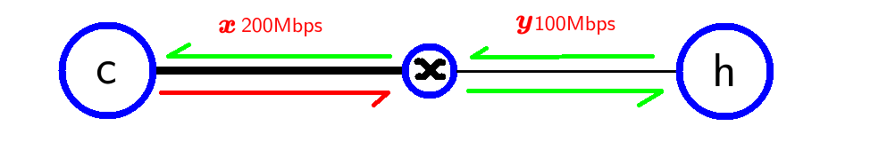
Example to understand Bottleneck Link
If a network has a throughput bottleneck, does it matter whether the slow link comes before or after?
For example:
c wants to send something to h. the bottleneck is on h's side. What throughput speed will the red arrow have? 200 or 100?
Note:
The question is about throughput only. Meaning we neglect the router's buffer and processing (little queuing delay, processing delay and also transmission delay).
Introduction
1-<number>

Slide 20
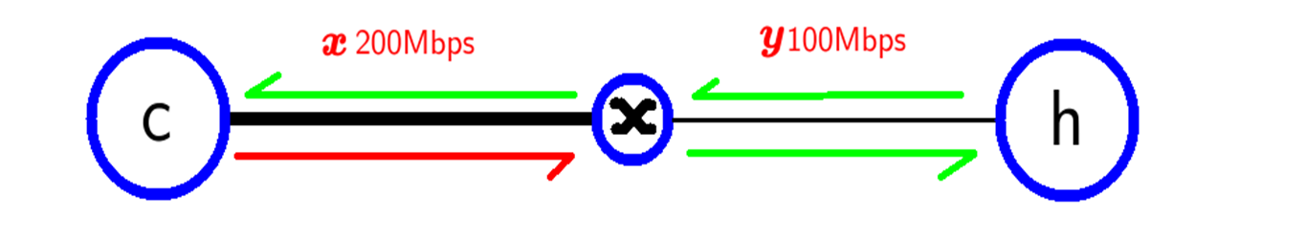
ANSWER:
Q: if a network has a throughput bottleneck, does it matter whether the slow link comes before or after?
No it doesn't, Only matters when destination is before or after that bottleneck link.
Q: What throughput speed will the red arrow have? 200 or 100?
Yes it will be bottlenecked at 100mbps. So bottleneck throughput speed would be of the lowest throughput link between h and c. So this bottleneck throughput will be applicable when the packet is sent from h to c also.
Introduction
1-<number>

Slide 21
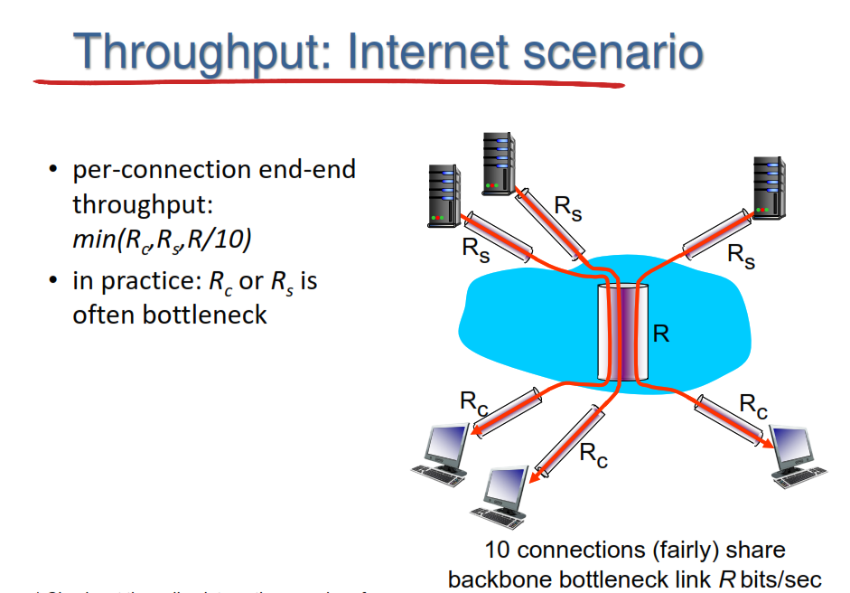
Introduction
1-<number>

Slide 22
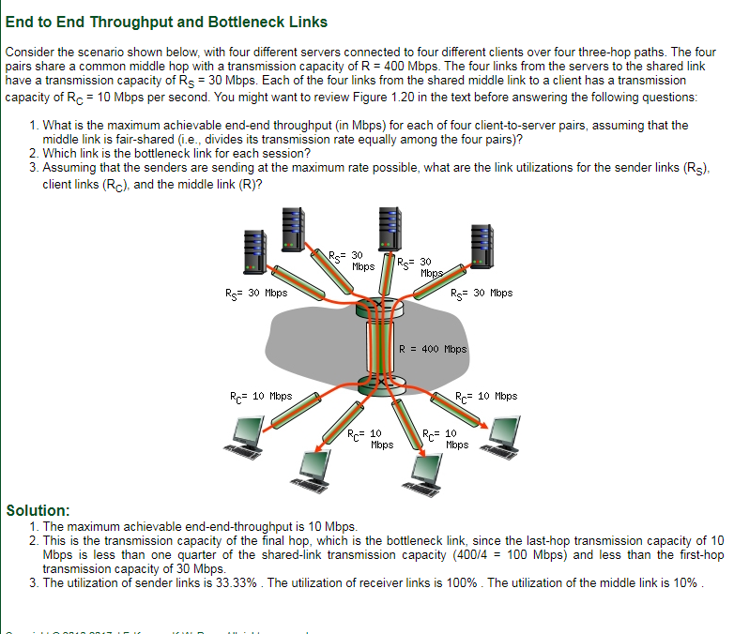
Introduction
1-<number>

Slide 23
Chapter 1: roadmap
  1.1 what is the Internet?
  1.2 network edge
    end systems, access networks, links
  1.3 network core
    packet switching, circuit switching, network structure
  1.4 delay, loss, throughput in networks
  1.5 protocol layers, service models
  1.6 networks under attack: security
  1.7 history
Introduction
1-<number>

Slide 24
Protocol “layers”
Networks are complex,
with many “pieces”:
  hosts
  routers
  links of various media
  applications
  protocols
  hardware, software
Question:
is there any hope of organizing structure of network?
…. or at least our discussion of networks?
Introduction
1-<number>

Slide 25

Example: organization of air travel
end-to-end transfer of person plus baggage
ticket (purchase)
baggage (check)
gates (load)
runway takeoff
airplane routing
ticket (complain)
baggage (claim)
gates (unload)
runway landing
airplane routing
airplane routing
How would you define/discuss the system of airline travel?
a series of steps, involving many services
Introduction: 1-<number>

Slide 26
Example: organization of air travel
ticket (purchase)
baggage (check)
gates (load)
runway takeoff
airplane routing
ticketing service
ticket (complain)
baggage (claim)
gates (unload)
runway landing
airplane routing
baggage service
gate service
runway service
routing service
airplane routing
layers: each layer implements a service
  via its own internal-layer actions
  relying on services provided by layer below
Introduction: 1-<number>

Slide 27
Why layering?
Approach to designing/discussing complex systems:
explicit structure allows identification, relationship of system’s pieces
  layered reference model for discussion
modularization eases maintenance, updating of system
  change in layer's service implementation: transparent to rest of system
  e.g., change in gate procedure doesn’t affect rest of system
Introduction: 1-<number>

Slide 28
Layered Internet protocol stack
application: supporting network applications
  HTTP, IMAP, SMTP, DNS
transport: process-process data transfer
  TCP, UDP
network: routing of datagrams from source to destination
  IP, routing protocols
link: data transfer between neighboring network elements
  Ethernet, 802.11 (WiFi), PPP
physical: bits “on the wire”
application
application
transport
transport
network
network
link
link
physical
physical
Introduction: 1-<number>

Slide 29
Services, Layering and Encapsulation
application
transport
network
link
physical
M
application
transport
network
link
physical
Application exchanges messages to implement some application service using services of transport layer
H_{t}
M
Transport-layer protocol transfers M (e.g., reliably) from one process to another, using services of network layer
transport-layer protocol encapsulates application-layer message, M, with transport layer-layer header H_{t} to create a transport-layer segment
  H_{t} used by transport layer protocol to implement its service
source
destination
Introduction: 1-<number>

Slide 30
Services, Layering and Encapsulation
application
transport
network
link
physical
M
application
transport
network
link
physical
H_{t}
M
Transport-layer protocol transfers M (e.g., reliably) from one process to another, using services of network layer
H_{n}
H_{t}
M
Network-layer protocol transfers transport-layer segment [H_{t} | M] from one host to another, using link layer services
network-layer protocol encapsulates transport-layer segment [H_{t} | M] with network layer-layer header H_{n} to create a network-layer datagram
  H_{n} used by network layer protocol to implement its service
source
destination
Introduction: 1-<number>

Slide 31
Services, Layering and Encapsulation
H_{n}
H_{t}
M
application
transport
network
link
physical
M
application
transport
network
link
physical
H_{t}
M
H_{n}
H_{t}
M
Network-layer protocol transfers transport-layer segment [H_{t} | M] from one host to another, using link layer services
H_{l}
H_{n}
H_{t}
M
Link-layer protocol transfers datagram [H_{n}| [H_{t} |M] from host to neighboring host, using network-layer services
source
link-layer protocol encapsulates network datagram [H_{n}| [H_{t} |M], with link-layer header H_{l} to create a link-layer frame
destination
Introduction: 1-<number>

Slide 32
Services, Layering and Encapsulation
application
transport
network
link
physical
M
application
transport
network
link
physical
M
message
H_{t}
M
H_{t}
M
segment
H_{n}
H_{t}
M
H_{n}
H_{t}
M
datagram
H_{l}
H_{n}
H_{t}
M
H_{l}
H_{n}
H_{t}
M
frame
source
destination
Introduction: 1-<number>

Slide 33
Encapsulation: an end-end view
source
message
M
application
transport
network
link
physical
segment
H_{t}
M
H_{t}
datagram
H_{n}
H_{t}
M
H_{n}
frame
H_{l}
H_{n}
H_{t}
M
link
physical
switch
destination
H_{n}
H_{t}
M
network
link
physical
M
application
transport
network
link
physical
H_{l}
H_{n}
H_{t}
M
H_{n}
H_{t}
M
H_{t}
M
H_{n}
H_{t}
M
H_{l}
H_{n}
H_{t}
M
router
Introduction: 1-<number>

Slide 34
A layered architecture allows us to discuss a well-defined, specific part of a large and complex system.
This simplification itself is of considerable value by providing modularity, making it much easier to change the implementation of the service provided by the layer.
As long as the layer provides the same service to the layer above it, and uses the same services from the layer below it, the.
remainder of the system remains unchanged when a layer’s implementation is changed.
(Note that changing the implementation of a service is very different from changing the
service itself!) For example, if the gate functions were changed (for instance, to have
people board and disembark by height), the remainder of the airline system would
remain unchanged since the gate layer still provides the same function (loading and
unloading people);
Introduction
1-<number>

Slide 35
For large and complex systems that are constantly being updated, the ability to change the implementation of a service without affecting other components of the system is another important advantage of layering
Introduction
1-<number>

Slide 36
Protocol Layering
To provide structure to the design of network protocols, network designers organize
protocols—and the network hardware and software that implement the protocols—
in layers
Each protocol belongs to one of the layers, just as each function in the
airline architecture Figure belonged to a layer.
We are again interested in the services that a layer offers to the layer above—the so-called service model of a layer.
Just as in the case of our airline example, each layer provides its service
by (1) performing certain actions within that layer and by (2) using the services
of the layer directly below it.
Introduction
1-<number>

Slide 37
A protocol layer can be implemented in software, in hardware, or in a combination of the two.
Application-layer protocols—such as HTTP and SMTP—are almost
always implemented in software in the end systems; so are transport-layer protocols.
Because the physical layer and data link layers are responsible for handling communication over a specific link, they are typically implemented in a network interface card (for example, Ethernet or WiFi interface cards) associated with a given link.
The network layer is often a mixed implementation of hardware and software.
Introduction
1-<number>

Slide 38
Protocol layering has conceptual and structural advantages [RFC 3439].
As we have seen, layering provides a structured way to discuss system components.
Modularity makes it easier to update system components.
We mention, however, that some researchers and networking engineers are vehemently opposed to layering [Wakeman 1992].
One potential drawback of layering is that one layer may duplicate lower-layer functionality.
For example, many protocol stacks provide error recovery on both a per-link basis and an end-to-end basis.
A second potential drawback is that functionality at one layer may need information (for example, a timestamp value) that is present only in another layer; this violates the goal of separation of layers.
Introduction
1-<number>

Slide 39
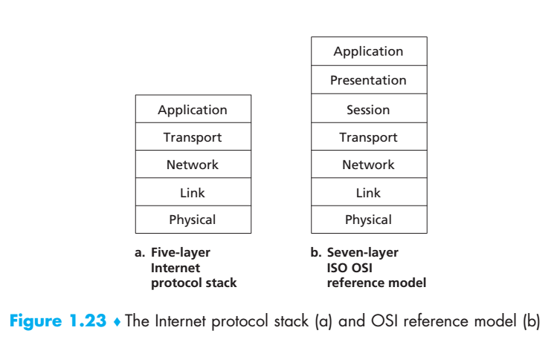
When taken together, the protocols of the various layers are called the protocol
stack. The Internet protocol stack consists of five layers: the physical, link, network,
transport, and application layers, as shown in Figure 1.23(a).
THIS BOOK START FROM APPLICATION TO PHYSICAL
Introduction
1-<number>

Slide 40
Application Layer
The application layer is where network applications and their application-layer protocols reside.
The Internet’s application layer includes many protocols, such as the
HTTP protocol (which provides for Web document request and transfer), SMTP
(which provides for the transfer of e-mail messages), and FTP (which provides for
the transfer of files between two end systems). namely, the domain name system (DNS). We’ll see in Chapter 2
An application-layer protocol is distributed over multiple end systems, with the
application in one end system using the protocol to exchange packets of information with the application in another end system.
We’ll refer to this packet of information at the application layer as a message.
Introduction
1-<number>

Slide 41
Transport Layer
The Internet’s transport layer transports application-layer messages between application endpoints.
In the Internet there are two transport protocols, TCP and UDP, either of which can transport application-layer messages.
TCP provides a connection-oriented service to its applications. This service includes guaranteed delivery of application layer messages to the destination and flow control (that is, sender/receiver speed matching).
The UDP protocol provides a connectionless service to its applications.
In this book, we’ll refer to a transport-layer packet as a segment.
Introduction
1-<number>

Slide 42
Network Layer
The Internet’s network layer is responsible for moving network-layer packets known as datagrams from one host to another.
The Internet transport-layer protocol (TCP or UDP) in a source host passes a transport-layer segment and a destination address to the network layer, just as you would give the postal service a letter with a destination address.
The network layer then provides the service of delivering the segment
to the transport layer in the destination host.
The Internet’s network layer includes the celebrated IP protocol, which defines
the fields in the datagram as well as how the end systems and routers act on these fields.
There is only one IP protocol, and all Internet components that have a network
layer must run the IP protocol.
The Internet’s network layer also contains routing protocols that determine the routes that datagrams take between sources and destinations.
Introduction
1-<number>

Slide 43
Link Layer
The Internet’s network layer routes a datagram through a series of routers between the source and destination.
To move a packet from one node (host or router) to the next node in the route, the network layer relies on the services of the link layer.
In particular, at each node, the network layer passes the datagram down to the link
layer, which delivers the datagram to the next node along the route. At this next node,
the link layer passes the datagram up to the network layer. The services provided by the link layer depend on the specific link-layer protocol that is employed over the link.
Examples of link layer protocols include Ethernet, WiFi, and the cable access network’s DOCSIS protocol.
The network layer will receive a different service from each of the different link-layer protocols. In this book, we’ll refer to the linklayer packets as frames.
Introduction
1-<number>

Slide 44
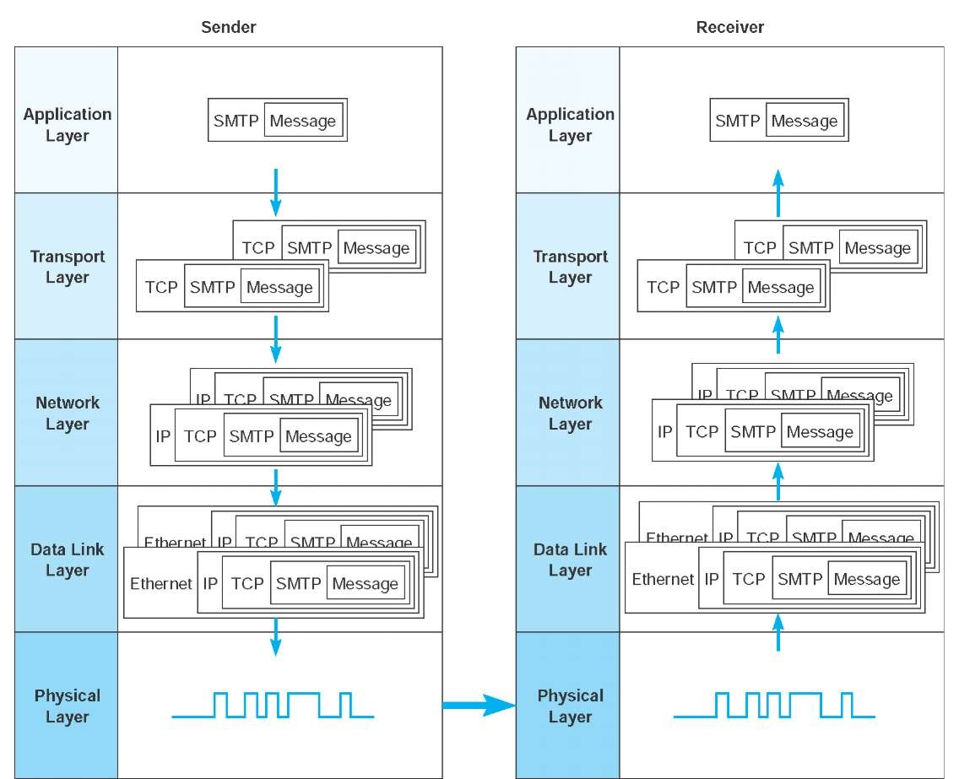
Introduction
1-<number>

Slide 45
ISO/OSI reference model
presentation: allow applications to interpret meaning of data, e.g., encryption, compression, machine-specific conventions
session: synchronization, checkpointing, recovery of data exchange
Internet stack “missing” these layers!
  these services, if needed, must be implemented in application
  needed?
application
presentation
session
transport
network
link
physical
Introduction
1-<number>

Slide 46
Chapter 1: roadmap
  1.1 what is the Internet?
  1.2 network edge
    end systems, access networks, links
  1.3 network core
    packet switching, circuit switching, network structure
  1.4 delay, loss, throughput in networks
  1.5 protocol layers, service models
  1.6 networks under attack: security
  1.7 history
Introduction
1-<number>

Slide 47
The field of network security is about how the bad guys can attack computer networks
and about how we, soon-to-be experts in computer networking, can defend networks against those attacks
Introduction
1-<number>

Slide 48
Network security
field of network security:
  how bad guys can attack computer networks
  how we can defend networks against attacks
  how to design architectures that are immune(NOT VULNERABLE) to attacks
Internet not originally designed with (much) security in mind
  original vision: “a group of mutually trusting users attached to a transparent network” ☺
  Internet protocol designers playing “catch-up”
  security considerations in all layers!
Introduction
1-<number>

Slide 49
Since we don’t yet have expertise in computer networking and Internet protocols,
we’ll begin here by surveying some of today’s more prevalent security-related problems
Introduction
1-<number>

Slide 50
We attach devices to the Internet because we want to receive/send data from/to the Internet.
This includes all kinds of good stuff, including Instagram posts, Facebook, Internet search results, streaming music, video conference calls, streaming movies, and so on.
But, unfortunately, along with all that good stuff comes malicious stuff—collectively known as malware = that can also enter and infect our devices
Malicious = intending or intended to do harm
Introduction
1-<number>

Slide 51
Once malware infects our device it can do all kinds of devious things, including deleting our files and installing spyware that collects our private information, such as social security numbers, passwords, and keystrokes, and then sends this (over the Internet, of course!) back to the bad guys.
Our compromised host may also be enrolled in a network of thousands of similarly compromised devices, collectively known as a botnet, which the bad guys control and leverage for spam e-mail distribution or distributed denial-of-service attacks against targeted hosts.
Devious: showing a skilful use of underhand tactics to achieve goals
Introduction
1-<number>

Slide 52
Much of the malware out there today is self-replicating: once it infects one host, from that host it seeks entry into other hosts over the Internet, and from the newly infected hosts, it seeks entry into yet more hosts.
Malware can spread in the form of a virus or a worm
Introduction
1-<number>

Slide 53
Viruses are malware = that require some form of user interaction to infect the
user’s device. The classic example is an e-mail attachment containing malicious executable Code If a user receives and opens such an attachment, the user inadvertently runs the malware on the device.
Typically, such e-mail viruses are self-replicating: once executed, the virus may send an identical message with an identical malicious attachment to, for example, every recipient in the user’s address book
Worms are malware = that can enter a device without any explicit user interaction.
For example, a user may be running a vulnerable network application to which an attacker can send malware.
In some cases, without any user intervention, the application may accept the malware from the Internet and run it, creating a worm.
The worm in the newly infected device then scans the Internet, searching for other hosts running the same vulnerable network application. When it finds other vulnerable hosts, it sends a copy of itself to those hosts.
Today, malware, is pervasive (penetrating) and costly to defend against
Introduction
1-<number>

Slide 54
Bad guys: put malware into hosts via Internet
malware can get in host from:
  virus: self-replicating infection by receiving/executing object (e.g., e-mail attachment)
  worm: self-replicating infection by passively receiving object that gets itself executed
spyware malware can record keystrokes, web sites visited, upload info to collection site
infected host can be enrolled in botnet, used for spam. DDoS attacks
Introduction
1-<number>

Slide 55
The Bad Guys Can Attack Servers and Network Infrastructure
Another broad class of security threats are known as denial-of-service (DoS)
attacks.
As the name suggests, a DoS attack renders a network, host, or other piece
of infrastructure unusable by legitimate users. Web servers, e-mail servers, DNS servers and institutional networks can all be subject to DoS attacks.
Internet DoS attacks are extremely common, with thousands of DoS attacks occurring every year [Moore 2001].
The site Digital Attack Map allows use to visualize the top daily DoS attacks worldwide [DAM 2016].
Introduction
1-<number>

Slide 56
Most Internet DoS attacks fall into one of three categories:
Vulnerability attack : This involves sending a few well-crafted messages to a vulnerable application or operating system running on a targeted host. If the right sequence of packets is sent to a vulnerable application or operating system, the service can stop or, worse, the host can crash.
Bandwidth flooding : The attacker sends a deluge of packets to the targeted host—so many packets that the target’s access link becomes clogged, preventing legitimate packets from reaching the server.
Connection flooding : The attacker establishes a large number of half-open or
fully open TCP connections (TCP connections are discussed in Chapter 3) at the
target host. The host can become so bogged down with these bogus connections
that it stops accepting legitimate connections.
Introduction
1-<number>

Slide 57

Bad guys: attack server, network infrastructure
Denial of Service (DoS): attackers make resources (server, bandwidth) unavailable to legitimate traffic by overwhelming (very great in amount.) resource with bogus traffic
1. select target
2. break into hosts around the network (see botnet)
3. send packets to target from compromised hosts
target
Introduction
1-<number>

Slide 58
Let’s now explore the bandwidth-flooding attack in more detail.
Recalling our delay and loss analysis discussion in Section 1.4.2, it’s evident that if the server has an access rate of R bps, then the attacker will need to send traffic at a rate of approximately R bps to cause damage.
If R is very large, a single attack source may not be able to generate enough traffic to harm the server.
Furthermore, if all the traffic emanates from a single source, an upstream router may be able to detect the attack and block all traffic from that source before the traffic gets near the server.
Introduction
1-<number>

Slide 59
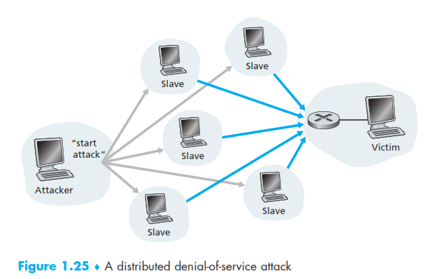
In distributed DoS (DDoS) attack, illustrated in Figure 1.25, the attacker
controls multiple sources and has each source blast traffic at the target. With this
approach, the aggregate traffic rate across all the controlled sources needs to be
approximately R to cripple the service. DDoS attacks leveraging botnets with thousands of comprised hosts are a common occurrence today [DAM 2016].
DDos attacks are much harder to detect and defend against than a DoS attack from a
Single host.
Introduction
1-<number>

Slide 60
We encourage you to consider the following question as you work your way through
this book:
What can computer network designers do to defend against DoS attacks?
Introduction
1-<number>

Slide 61
Bad guys can sniff packets
packet “sniffing”:
  broadcast media (shared Ethernet, wireless)
  promiscuous network interface reads/records all packets passing by
A
C
src:B dest:A payload
B
  wireshark software used for end-of-chapter labs is a (free) packet-sniffer
Introduction
1-<number>

Slide 62
Bad guys can use fake addresses
IP spoofing: The ability to inject packets into the Internet with a false source address is known as IP spoofing, and is but one of many ways in which one user can masquerade as another user
A
C
src:B dest:A payload
B
… lots more on security (throughout, Chapter 8)
Introduction
1-<number>

Slide 63
Chapter 1: roadmap
  1.1 what is the Internet?
  1.2 network edge
    end systems, access networks, links
  1.3 network core
    packet switching, circuit switching, network structure
  1.4 delay, loss, throughput in networks
  1.5 protocol layers, service models
  1.6 networks under attack: security
  1.7 history
Introduction
1-<number>

Slide 64

Internet history
1961-1972: Early packet-switching principles
1961: Kleinrock - queueing theory shows effectiveness of packet-switching
1964: Baran - packet-switching in military nets
1967: ARPAnet conceived by Advanced Research Projects Agency
1969: first ARPAnet node operational
1972:
  ARPAnet public demo
  NCP (Network Control Protocol) first host-host protocol
  first e-mail program
  ARPAnet has 15 nodes
Introduction
1-<number>

Slide 65
Internet history
1972-1980: Internetworking, new and proprietary nets
1970: ALOHAnet satellite network in Hawaii
1974: Cerf and Kahn - architecture for interconnecting networks
1976: Ethernet at Xerox PARC
late70’s: proprietary architectures: DECnet, SNA, XNA
late 70’s: switching fixed length packets (ATM precursor)
1979: ARPAnet has 200 nodes
Cerf and Kahn’s internetworking principles:
  minimalism, autonomy - no internal changes required to interconnect networks
  best effort service model
  stateless routers
  decentralized control
define today’s Internet architecture
Introduction
1-<number>

Slide 66
Internet history
1980-1990: new protocols, a proliferation of networks
1983: deployment of TCP/IP
1982: smtp e-mail protocol defined
1983: DNS defined for name-to-IP-address translation
1985: ftp protocol defined
1988: TCP congestion control
new national networks: CSnet, BITnet, NSFnet, Minitel
100,000 hosts connected to confederation of networks
Introduction
1-<number>

Slide 67
Internet history
1990, 2000’s: commercialization, the Web, new apps
early 1990’s: ARPAnet decommissioned
1991: NSF lifts restrictions on commercial use of NSFnet (decommissioned, 1995)
early 1990s: Web
  hypertext [Bush 1945, Nelson 1960’s]
  HTML, HTTP: Berners-Lee
  1994: Mosaic, later Netscape
  late 1990’s: commercialization of the Web
late 1990’s – 2000’s:
more killer apps: instant messaging, P2P file sharing
network security to forefront
est. 50 million host, 100 million+ users
backbone links running at Gbps
Introduction
1-<number>

Slide 68
Internet history
2005-present
~5B devices attached to Internet (2016)
  smartphones and tablets
aggressive deployment of broadband access
increasing ubiquity of high-speed wireless access
emergence of online social networks:
  Facebook: ~ one billion users
service providers (Google, Microsoft) create their own networks
  bypass Internet, providing “instantaneous” access to search, video content, email, etc.
e-commerce, universities, enterprises running their services in “cloud” (e.g., Amazon EC2)
Introduction
1-<number>

Slide 69
Introduction: summary
covered a “ton” of material!
Internet overview
what’s a protocol?
network edge, core, access network
  packet-switching versus circuit-switching
  Internet structure
performance: loss, delay, throughput
layering, service models
security
history
you now have:
context, overview, “feel” of networking
more depth, detail to follow!
Introduction
1-<number>

Slide 70
Chapter 1
Additional Slides
Introduction
1-<number>

Slide 71


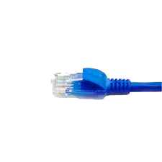

application
(www browser,
email client)
packet
analyzer
application
OS
packet
capture
(pcap)
Transport (TCP/UDP)
Network (IP)
Link (Ethernet)
Physical
copy of all Ethernet frames sent/received

Slide 72
What is Internet Speed?
Internet speed, the number they give you (5 Mbps, for example), has nothing to do with how fast your internet works. It’s not like a car or motorcycle where you can measure how fast it goes in miles per hour (mph).
Instead, internet speed is your (allocated) bandwidth. Bandwidth is the amount of data that can be sent to you, usually measured in seconds. For example, 5 Mbps would mean that you can receive up to 5 megabits of data per second.
Introduction
1-<number>

Slide 73
http://gaia.cs.umass.edu/kurose_ross/interactive/
https://news.jpy.com/kbase/support-articles/2015/9/7/calculating-network-data-transfer-speeds
https://www.geeksforgeeks.org/packet-switching-and-delays-in-computer-network/
https://www.ics.uci.edu/~keldefra/teaching/spring2013/uci_cs132/problemsets/CS132_EECS148_ProblemSet1_Solution.pdf
Introduction
1-<number>

Slide 74
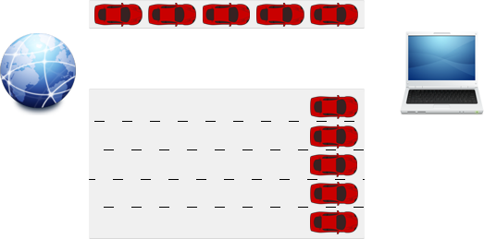
How Does Bandwidth Work?
The best way to explain (and understand) how bandwidth (and your internet speed) works is by using an analogy.
In other words, say 1 Mbps is the equivalent to a 1 lane freeway. And let’s say that you were trying to download an image, which is 5 Mb in size. So if you had a bandwidth of 1 Mbps (1 lane freeway) it would take you roughly 5 seconds to download the image.
Now let’s say that you have a 5 Mbps (bandwidth) connection, or a 5 lane freeway. How fast will you receive your image? 1 second.
More bandwidth means that you’ll receive more data at the same time. In this example, you can download 5 images with the wider bandwidth in the same time you could 1 with the narrower bandwidth.
What’s important to note here, and this confuses a lot of people, is that your internet isn’t any faster from 1 Mbps to 5 Mbps, or however much bandwidth your connection has. Your data is just transferred to you at a faster rate because more data can be sent at the same time. It’s more efficient, making your internet perceptually faster, not technically faster.
Introduction
1-<number>

